Slide 1
Agriculture in Less Developed Countries
Shifting cultivation
Characteristics of shifting cultivation
Future of shifting cultivation
Pastoral nomadism
Characteristics of pastoral nomadism
Future of pastoral nomadism
Intensive subsistence agriculture
Intensive subsistence with wet rice dominant
Intensive subsistence with wet rice not dominant
Plantation farming

Slide 2
World Climate Regions
Fig. 10-5a: Simplified map of the main world climate regions (see also Fig. 2-2).

Slide 3
World Agriculture Regions
Fig. 10-5b: Locations of the major types of subsistence and commercial agriculture.

Slide 4
Shifting Cultivation
What is shifting cultivation?
A form of subsistence agriculture in which people shift activity from one field to another; each field is used for crops for a relatively few years and left fallow for a relatively long period.
Why do you think we call it shifting cultivation as opposed to agriculture?
When you use the term agriculture it is usually referenced to using greater tools and animals and a more sophisticated modification of the landscape.

Slide 5
Shifting Cultivation continued…
What are the two hallmarks?
Slash and burn agriculture
Growing crops on a cleared field until soil nutrients are depleted. They then leave it fallow so the soil can recover.
What crops are grown?
*Vary by local custom and taste. The predominant crops include……
Southeast Asia: Rice
South America: Corn and Cassava
Africa: millet and sorghum
Others include: yams, sugarcane, plantain, and vegetables

Slide 6
Shifting Cultivation in Guatemala
Dense vegetation has been cut and is being burned to open land for farming.

Slide 7
Land Clearing in Colombia
Bulldozers are used to plow a road through the rain forest in Colombia.

Slide 8
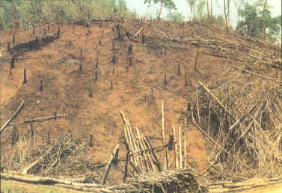
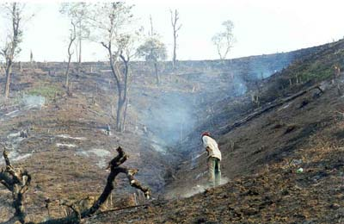
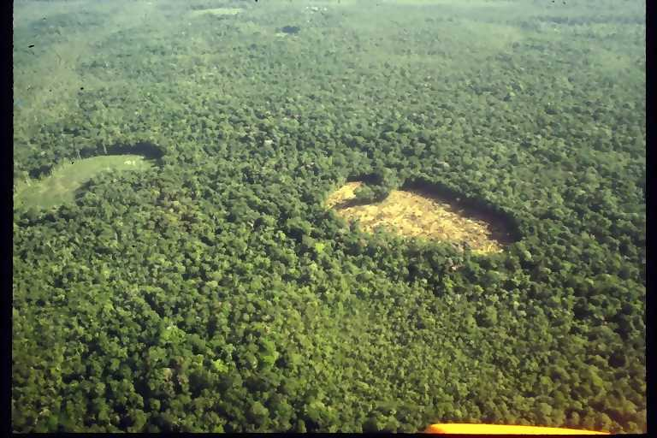
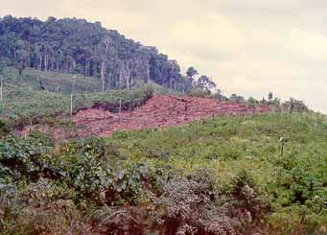

Slide 9
Pastoral Nomadism
What is pastoral nomadism?
A form of subsistence agriculture based on herding domesticated animals.
What do the animals provide?
-milk, and their skins and hair are used for clothing and tents
Important to know:
Pastoral nomads consume mostly grain rather than meat
Animals are commonly not slaughtered, although dead ones may be consumed
The size of their heard is both important measure of power and prestige and their main security during adverse environmental conditions.

Slide 10
Pastoral nomadism continued…
Choice of animals include:
Camel
Sheep and Goats
Horse
Important:
*The typical nomadic family needs 25 to 60 goats or sheep or 10 to 25 camels.

Slide 11
Pastoral Nomads in Iran
Qashqai nomads using paved roads to move their animals near Shiraz, Iran.

Slide 12
Intensive Subsistence Agriculture
What is it?
A form of subsistence agriculture in which farmers must expend a relatively large amount of effort to produce the maximum feasible yield from a parcel of land.
(Basically, the farmers must work more intensively to subsist on a parcel of land)
Important: ¾’s of worlds people live in LDC’s and this is the system used

Slide 13
Intensive Subsistence with wet rice dominant
Wet rice? Wet rice refers to the practice of planting rice on dry land in a nursery and then moving the seedlings to a flooded field to promote growth.
Occupies a small percentage of Asia’s agricultural land, but it’s the regions most important source of food.
What does it mean to be dominant?
- simply, this means it is the dominant type of agriculture in Southeast China, East India, and much of Southeast Asia.

Slide 14
Intensive Subsistence with Wet Rice Not Dominant
What is meant by wet rice not dominant?
More than one harvest can be obtained some years through skilled use of crop rotation

Slide 15
World Rice Production, 2005
Fig. 10-6: Asian farmers grow over 90% of the world’s rice. India and China alone account for over half of world rice production.

Slide 16
Wet Rice Terraces in Indonesia
Terraces create flat land for wet (irrigated) rice on hilly land in Indonesia.

Slide 17
Rice Harvesting, Indonesia
Wet rice is often harvested by hand in Asia.

Slide 18
