Slide 1
Agriculture in Developed Countries
Mixed crop and livestock farming
Dairy farming
Grain farming
Livestock ranching
Mediterranean agriculture
Commercial gardening and fruit farming
Access to markets

Slide 2
Mixed Crop and Livestock
All land used to grow crops but ¾ of the income comes from the sale of animal products
Crop rotation
  two-field- crop grown in one field while the other is left fallow
  four-field- root crop in field A, cereal in field B, “rest” crop in field C, root crop in field D

Slide 3
Dairy Farming
Milkshed- the surrounding a city from which milk can be supplied without spoiling
Regions specialize in “milk products” because of the distance from the markets
Problems: declining revenues, rising costs, and feeding cows in the winter

Slide 4
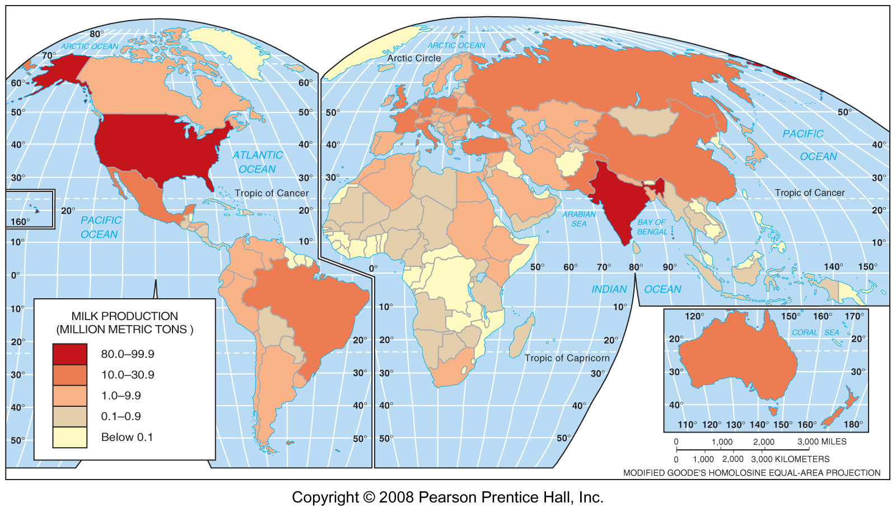
World Milk Production, 2005
Fig 10-8: Milk production reflects wealth, culture, and environment. It is usually high in MDCs, especially production per capita, and varies considerably in LDCs.

Slide 5
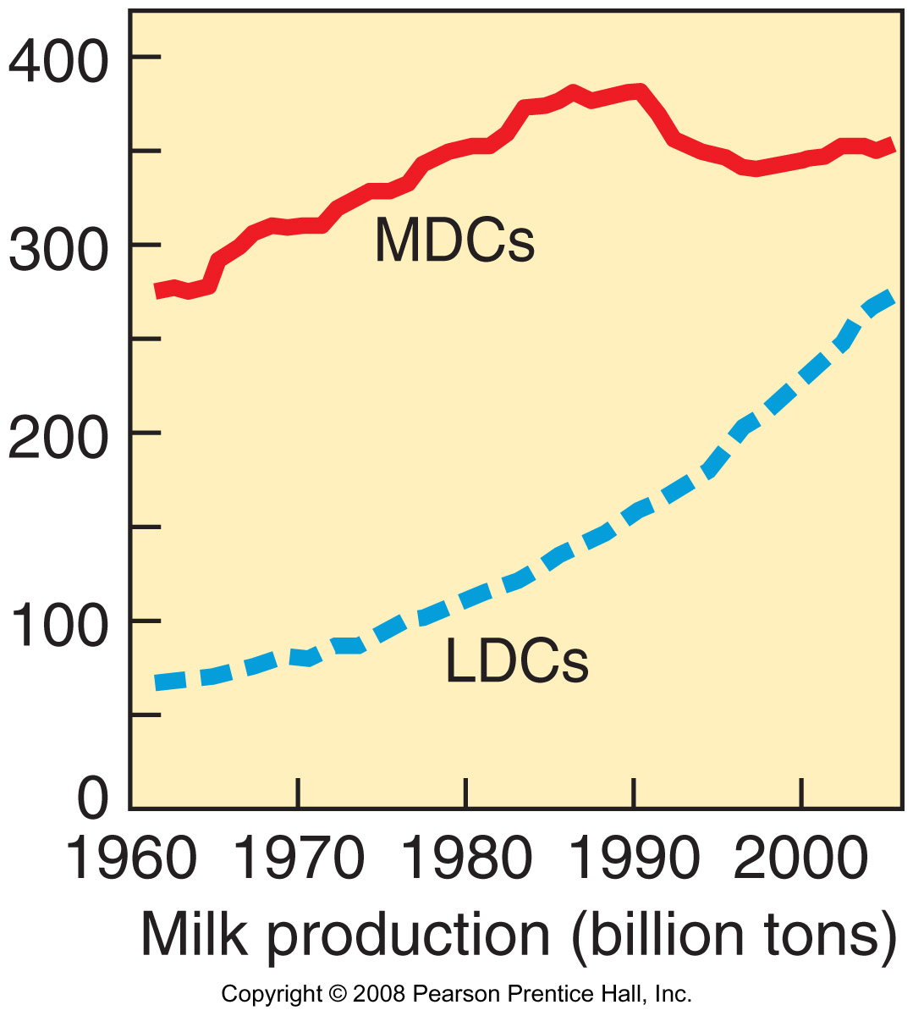
Milk Production in MDCs & LDCs
1960-2005
Milk production has grown more rapidly in LDCs than in MDCs since the 1960s.

Slide 6
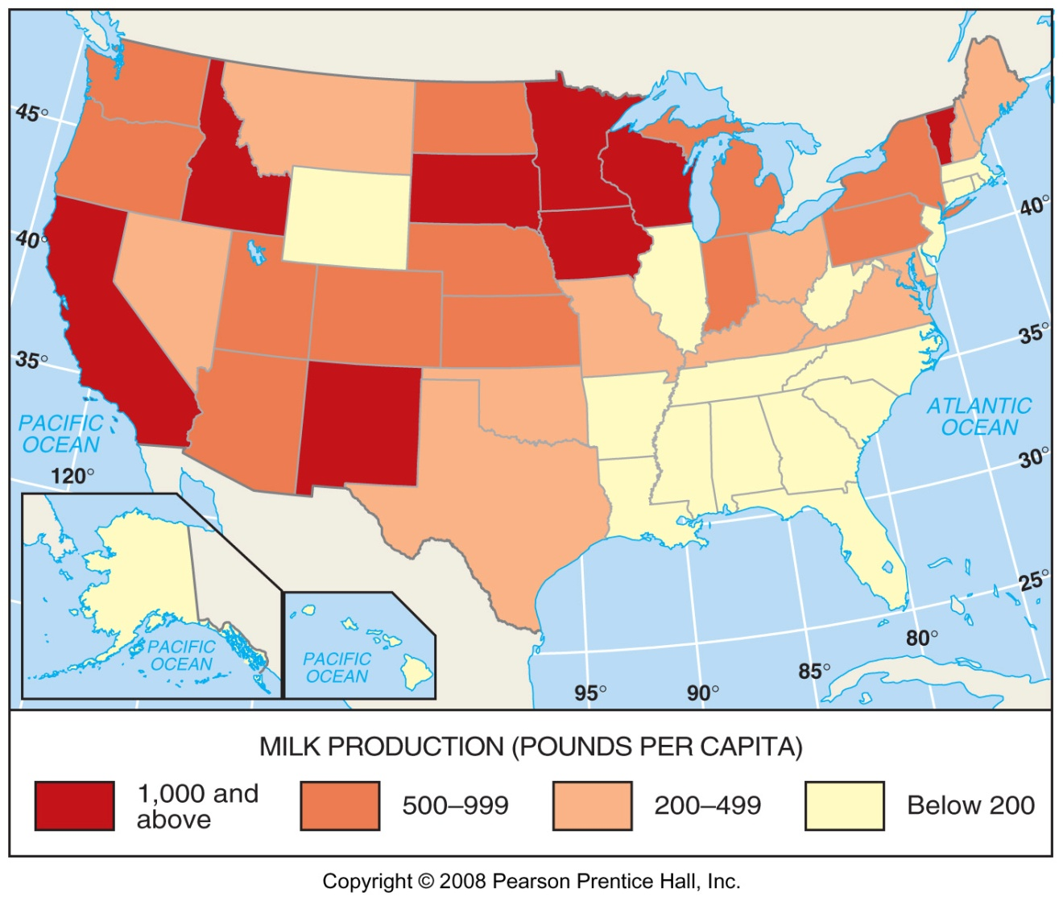
U.S. Milk Production, 2005

Slide 7
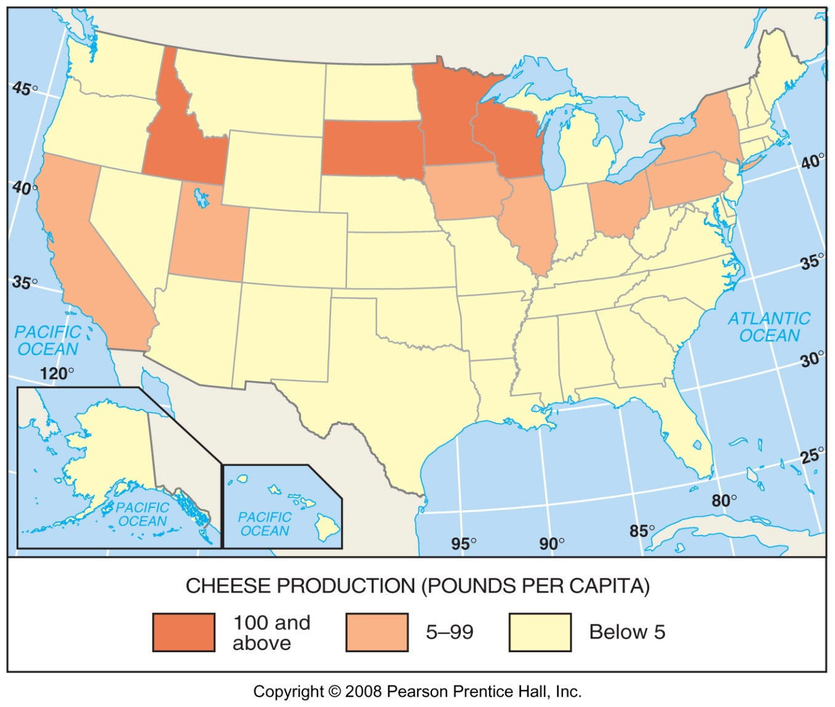
U.S. Cheese Production, 2005

Slide 8
Grain Farming
“commercial grain farming” is primarily for consumption by humans
Three regions of grain production
  Winter-Kansas, Colorado, and Oklahoma
  Spring- Dakotas, and Montana
  Palouse- Washington

Slide 9
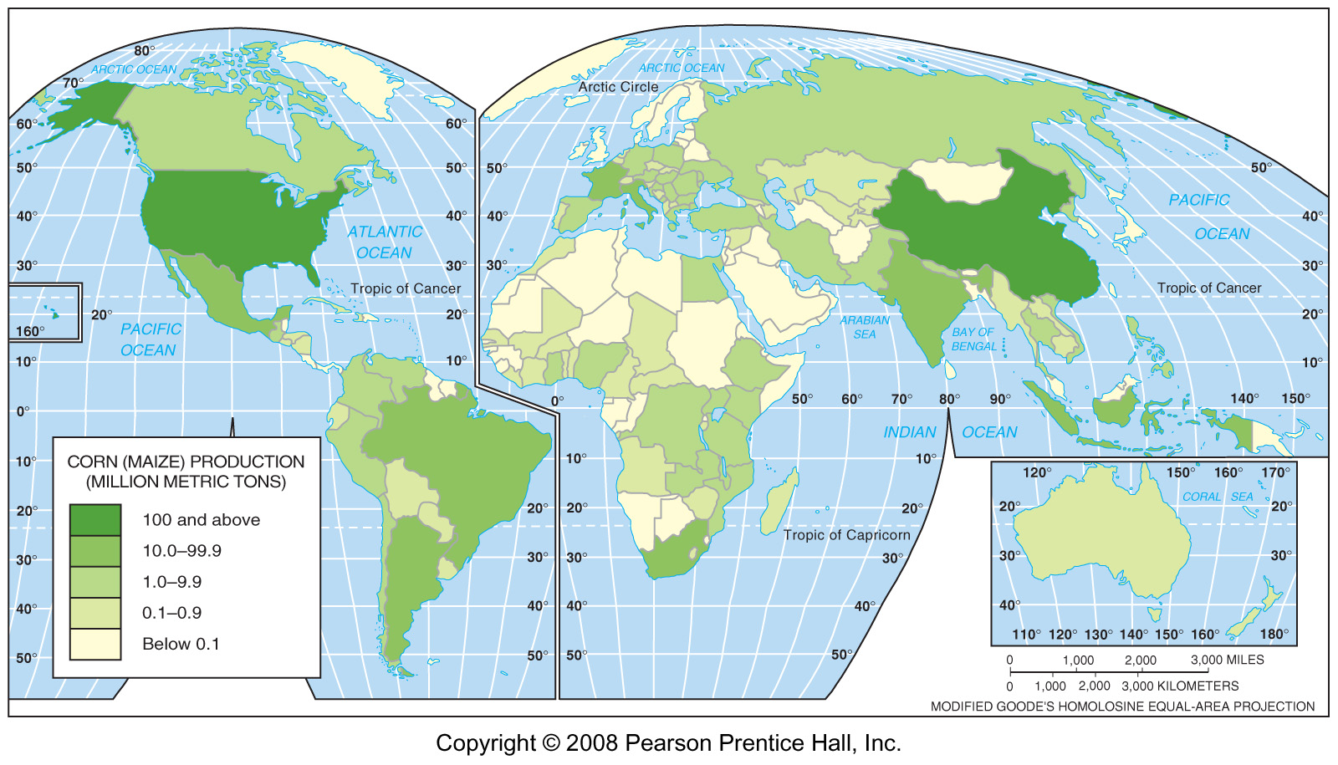
World Corn Production, 2005
Fig. 10-7: The U.S. accounts for about 40% of world corn (maize) production. China is the 2nd largest producer. Much of the corn in both countries is used for animal feed.

Slide 10
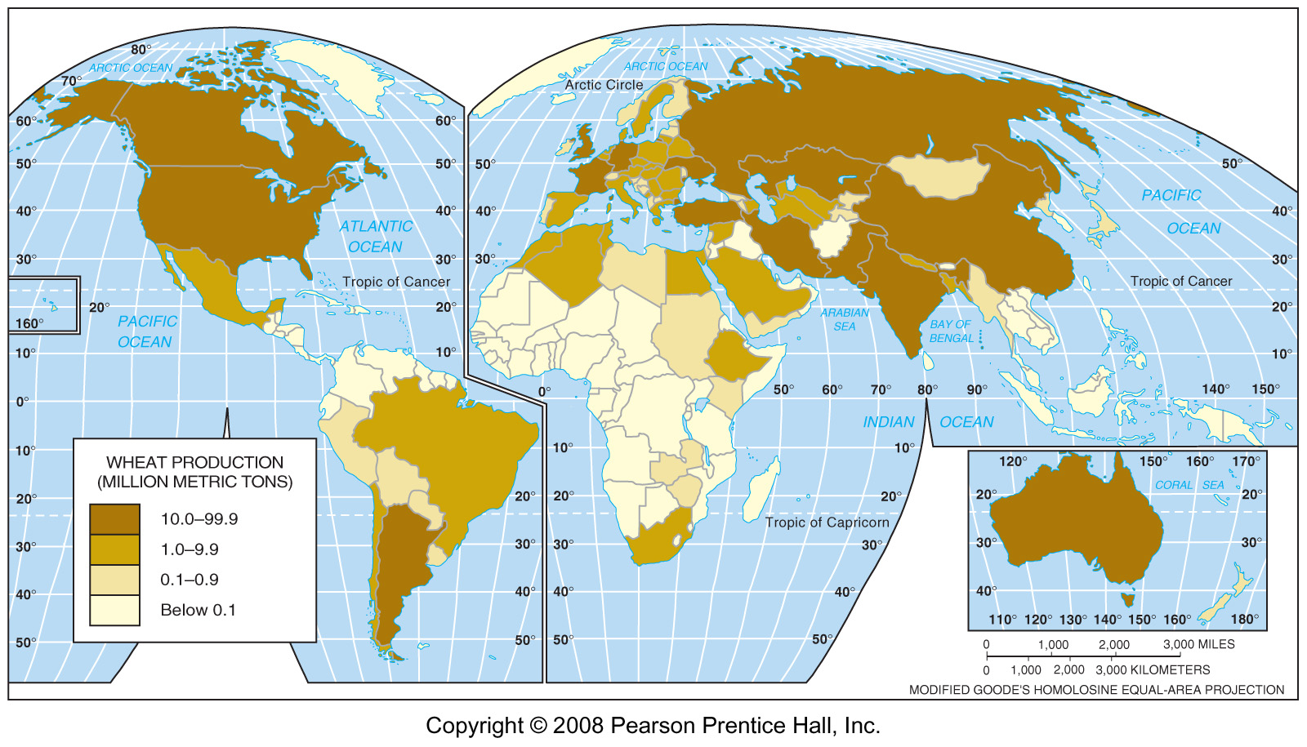
World Wheat Production, 2005
Fig. 10-10: China is the world’s leading wheat producer, but the U.S. is the largest producer of wheat for sale and the largest exporter.

Slide 11
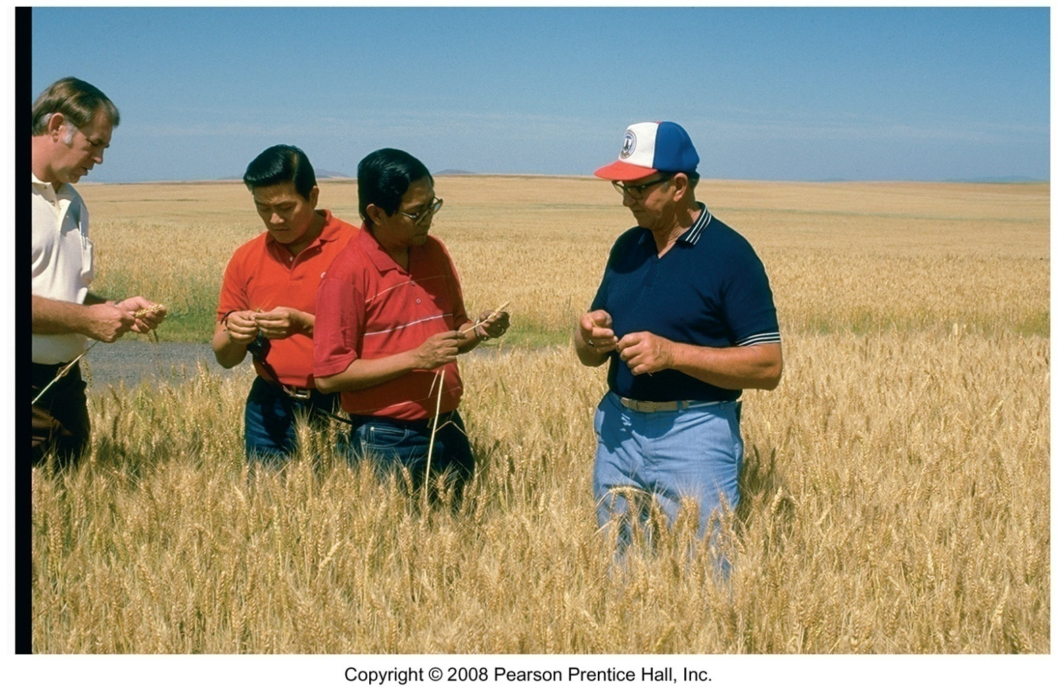
U.S. Wheat Farmer
A U.S. wheat farmer in Idaho is selling wheat to Asian buyers.

Slide 12
Livestock Ranching
Open range vs fixed location
Longhorns or herefords

Slide 13
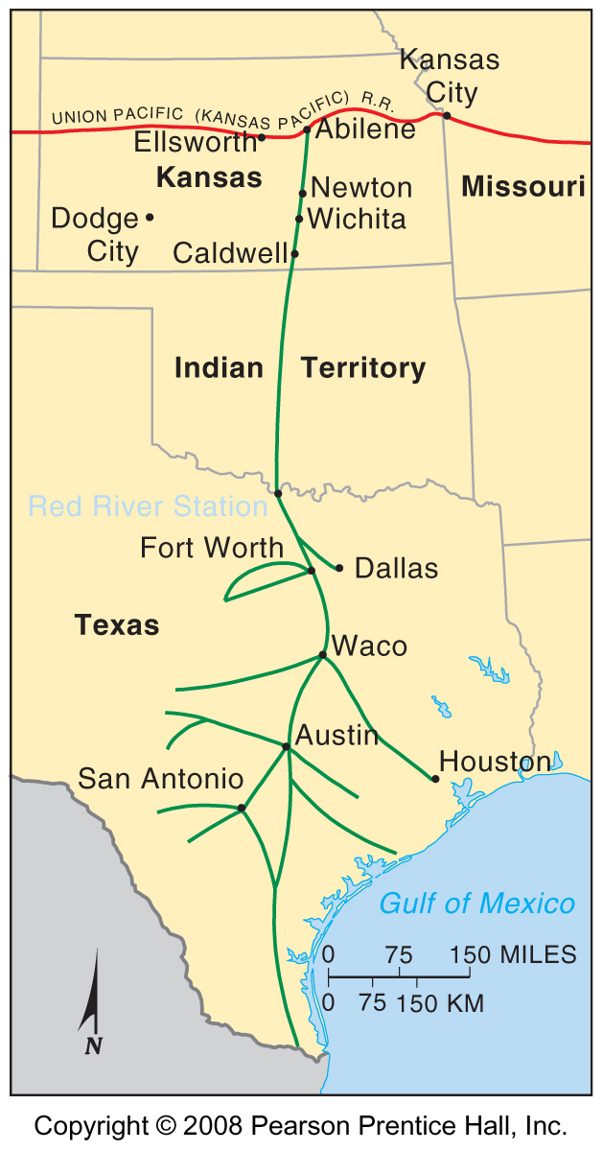
The Chisholm Trail
Fig. 10-11: The Chisholm Trail became famous as the main route for cattle drives from Texas to the railheads in Kansas.

Slide 14
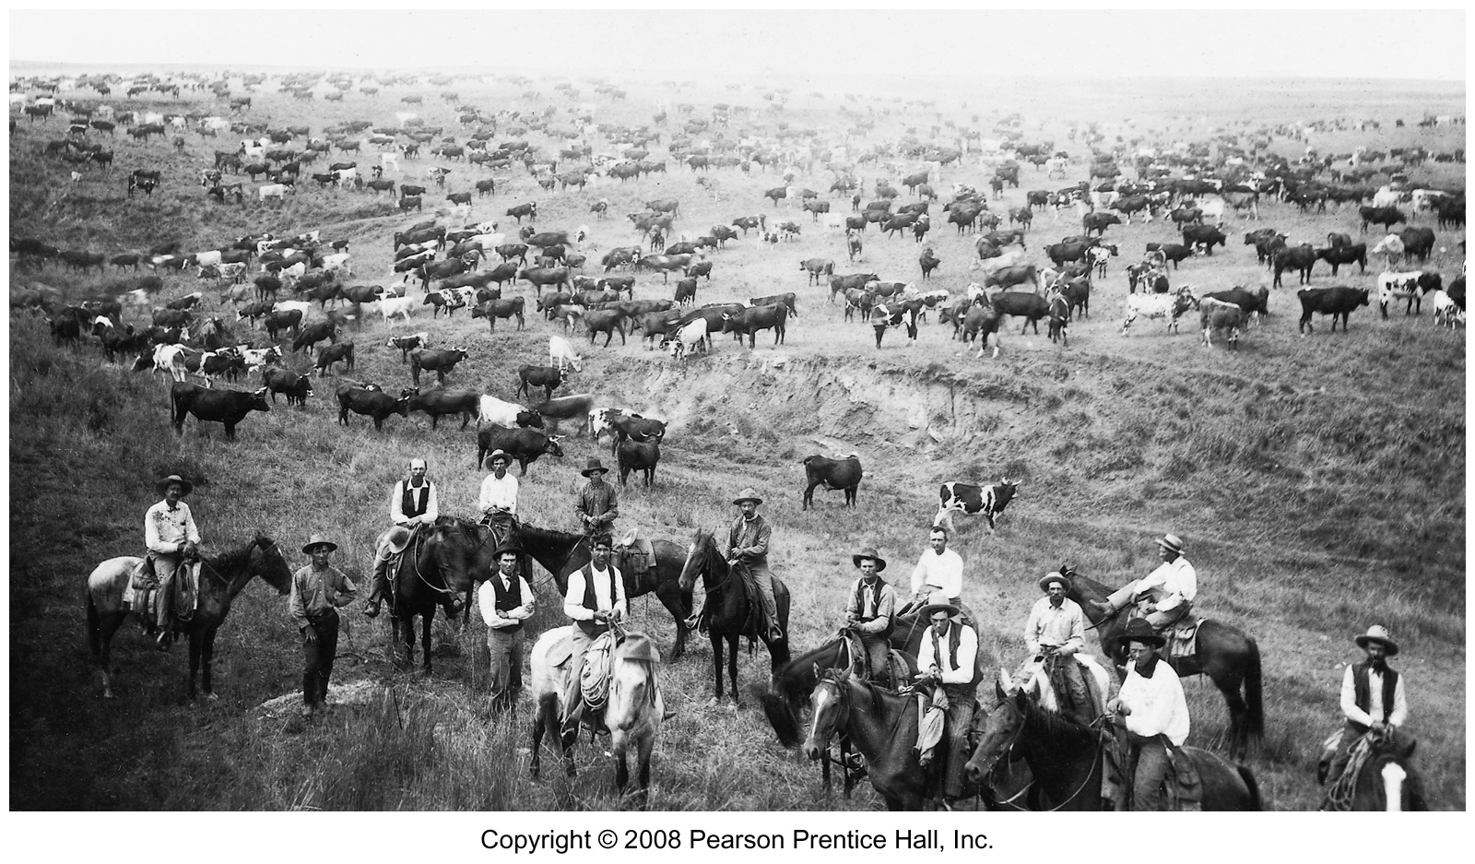
Cattle Drive on the Chisholm Trail

Slide 15
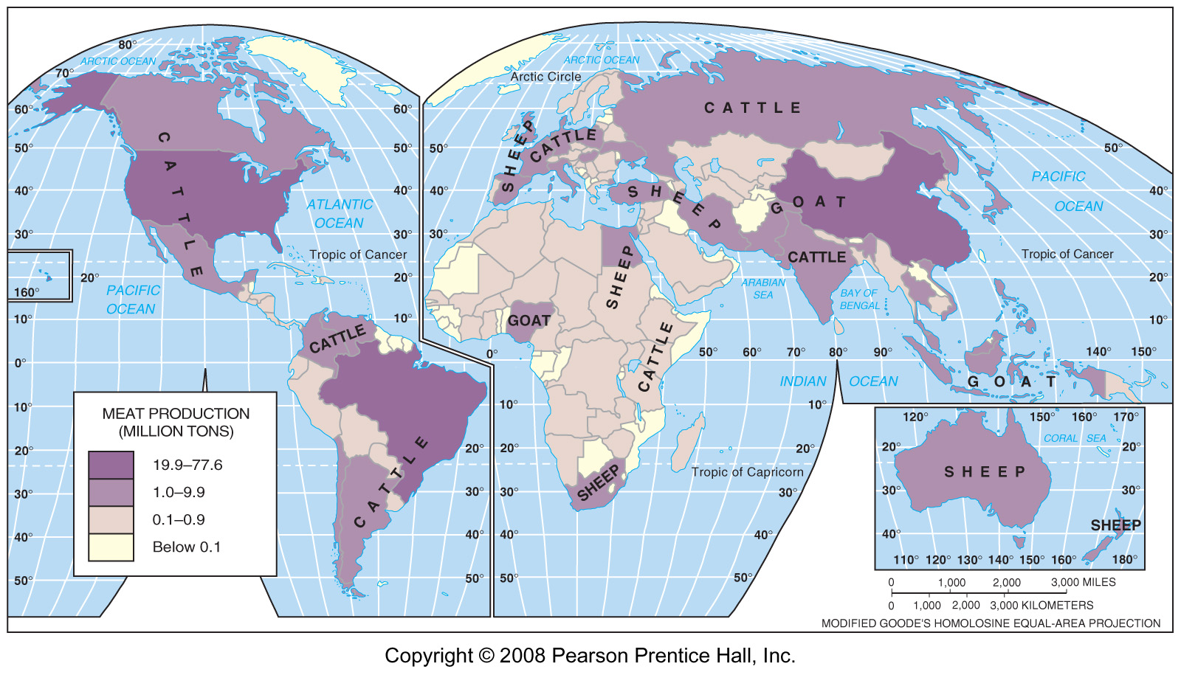
Meat Production on Ranches
Fig 10-12: Cattle, sheep and goats are the main meat animals raised on ranches.

Slide 16
Mediterranean Agriculture
Most crops in Mediterranean lands are grown for human consumption rather than for animal feed.
Horticulture- the growing of fruits, vegetables, and flowers
Two most important cash crops are olives and grapes

Slide 17
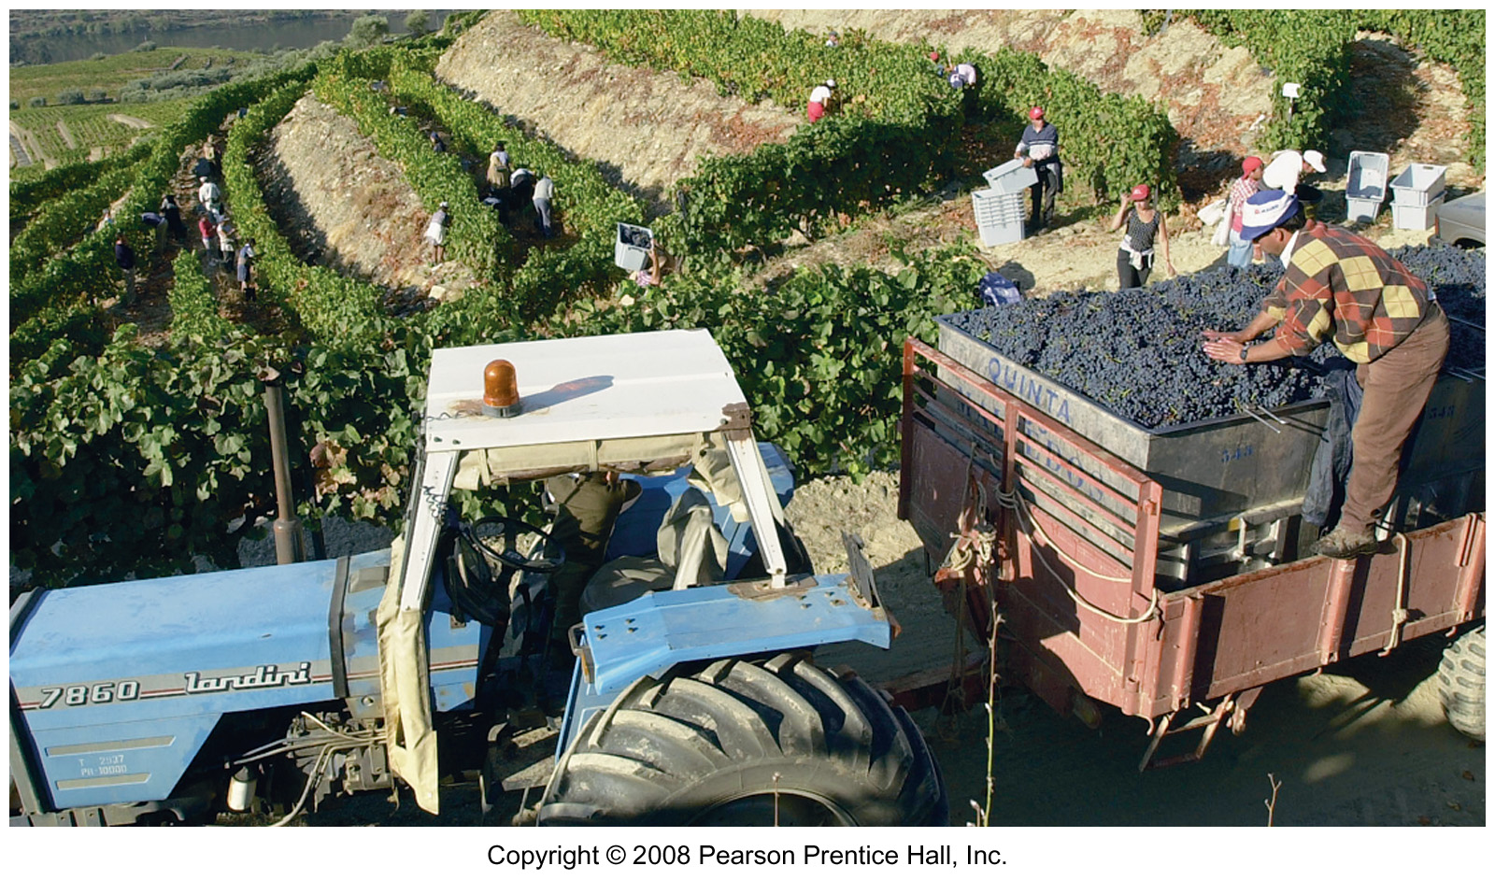
Vineyard in Portugal
Grapes loaded in vineyards on slopes above the Douro River in northern Portugal.

